Slide 1
Open Education Resource
LEARNING CENTRE
TOOLBOX
April 2024
HANDS-ON OPEN EDUCATION RESOURCES
A LEARNING CENTRE TOOLBOX
Created By
FabConnetHer Partners
www.fabconnecther.eu

Slide 2
LEARNING
CENTRE TOOLBOX
Working to empower future female innovators through inspiration, skills, and networks to make an impact in the field of STEAM through education, reemployment or entrepreneurship

Slide 3
TABLE OF CONTENTS
01
Overview 4
About FabConnectHer project 4
Glossary 5
What is the FabConnectHer Toolbox? 5
Why is the FabConnectHer Toolbox important? 6
How can the FabConnectHer Toolbox be used effectively 7
02
Tailored Learning Pathways 8
Pedagogic Approaches - Beta & Tech Mentality 8
Designing Learning pathways 9
Practical tutorials 12
03
Ready-to-use Open Educational Resources (OER’s) 14
Learning Path 1
Hands-On Exploratory Path for Girls (8-15 years old) 15
Learning Path 2
Tailored Programme for Female Students (15+) 16
Learning Path 3
Innovation and Entrepreneurship Path for Women Innovators (25+) 17
04
Guide to setting up and promoting
a FabConnectHer Learning Centre 18
Learning insights 18
Diversity and Inclusion strategy 20
Best practices for sustainability 21
05
Promotion and impact 23
SCOPES DF chapter 23

Slide 4
01
Overview
FabConnectHer is an ERASMUS+ project aimed at empowering women and girls in STEAM (Science, Technology, Engineering, Arts, and Mathematics) through education, reemployment, and entrepreneurship.
The project is working to tackle the gender gap by combining various approaches, such as practical learning lessons, mentoring and role modelling.
Here are the 3 key project outputs:
01 HANDS ON Open Education Resources (OERS)
Provides practical resources for educators to implement tailored activities to different age groups in three Learning Pathways, including Hands-on exploratory path for girls aged 8–15, Career-focused programmes for young women 15+, and entrepreneurship training for women innovators 25+.
02 MentHER Program
Connects female professionals in STEAM with students to provide personalized mentorship, fostering skill-building, career exploration, and a supportive learning environment.
03 EU Lab-to-Lab Educators Forum
Establishes a collaborative ecosystem among Fab Labs across Europe to share knowledge and co-create innovative solutions, culminating in a challenge to develop practical prototypes.

Slide 5
Glossary
FCH FabConnectHer
STEAM Science, Technology, Engineering, Art and Mathematics.
OERs Open Educational Resources
VET Vocational education and training
LP Learning Pathway
What is the FabConnectHer Toolbox?
The FabConnectHer Toolbox resources focus on empowering future female innovators through skill development, confidence building, and increased opportunities for social and professional integration in the STEAM fields.
These resources are designed and piloted in three tailored learning paths, grounded in the Bèta & Tech Mentality Model, that VET educators can provide girls and women of various ages in experimentation with design, technical skills (including digital fabrication, electronics, and programming tools and platforms), and career pathways.
This Toolbox is
divided in the
following sections:
01 Tailored Learning Pathways rooted in B&T Mentality
02 Ready-to-use OERs
03 Guide to setting up and promoting a Learning Centre
04 Promotion and impact

Slide 6
Why is the FabConnectHer Toolbox important?
The FabConnectHer Toolbox is designed to make it easier for educators, trainers, and FabLab facilitators to create inclusive and engaging STEAM learning experiences. Whether you’re looking to set up a learning centre, introduce creative digital skills, or support women and girls in technology, this Toolbox gives you practical, ready-to-use resources.
Here’s how it can help you:
01 Access Ready-to-Use Learning Materials)
Get open educational resources (OERs) designed to teach creativity, technology, career skills, and entrepreneurship in an inclusive way. These materials are designed for diverse abilities and skill levels.
02 Set Up and Promote a FabConnectHer Learning Centre
Follow a step-by-step guide to establish and grow a learning hub that supports women and girls in STEAM.
03 Use the Best Teaching Strategies
Learn how to apply effective, learner-centred teaching methods for different ability levels, whether you're running in-person, hybrid, or digital classes.
04 Ensure Real-World Relevance
Benefit from resources that have been tested with learners to make sure they meet real needs.
05 Reach More People
Access the materials in a digital, open-access format, making it easy to share with the wider VET education sector and FabLab community.
By using the resources in this Toolbox, you can create meaningful learning opportunities, expand access to STEAM education, and help more women and girls gain confidence in technology.

Slide 7
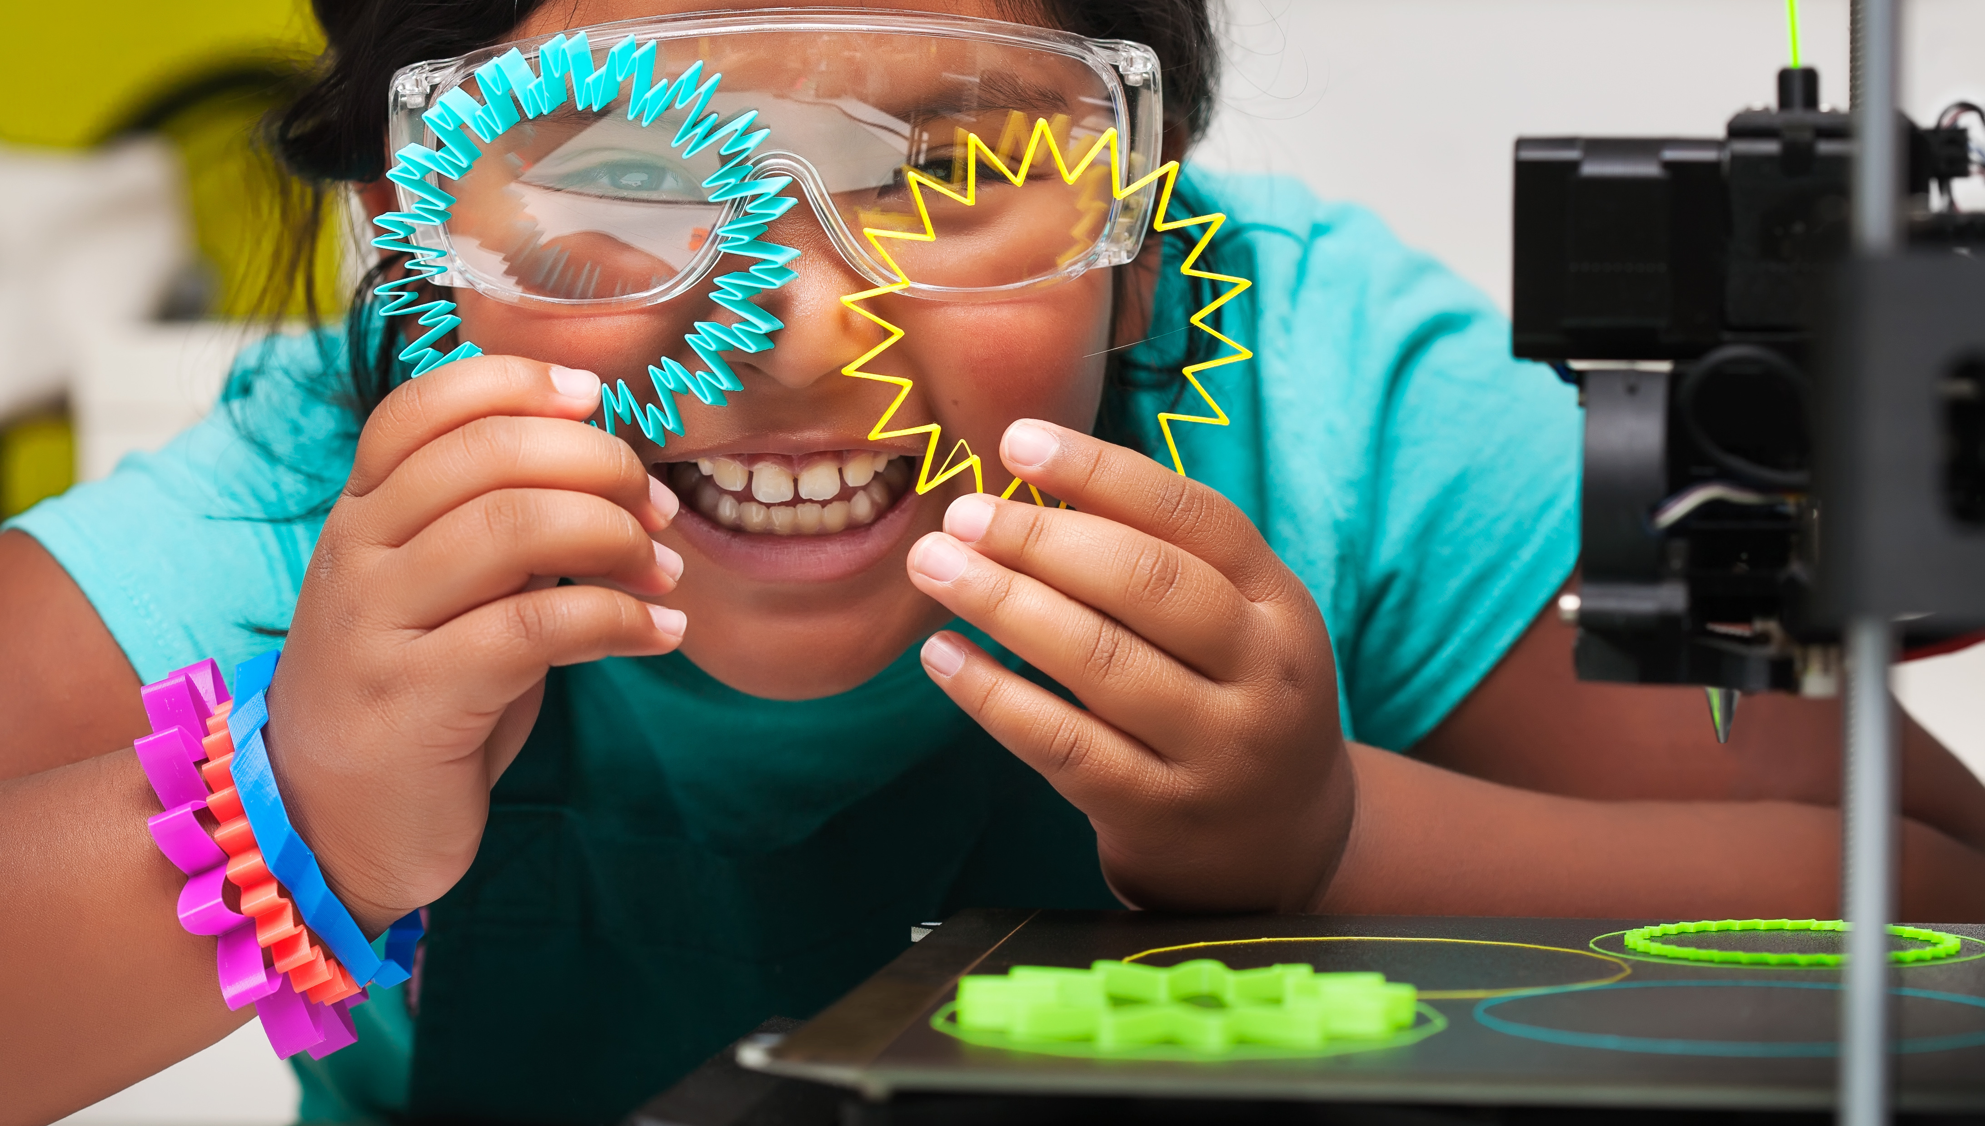
How can the FabConnectHer Toolbox be used effectively?
The FabConnectHer Toolbox is a valuable practical resource for VET educators and practitioners, enabling them to create more inclusive learning environments, deliver impactful STEAM learning experiences, and adapt activities to various contexts.
Its modular design allows customization to meet specific needs, whether in schools, Fab Labs, or community organizations. Users can effectively utilize the toolbox OERs by identifying their target group, selecting an appropriate learning path, implementing activities, and reflecting on the learning experience.
The Toolbox follows the 5R Permissions of OER:
RETAIN
Make and keep copies
REUSE
Use in a variety of ways
REVISE
Adapt, modify, and improve
REMIX
Combine multiple resources
REDISTRIBUTEShare with others

Slide 8
02
Tailored Learning Pathways
Pedagogic Approaches - Beta & Tech Mentality Model
Young people think about technology in very different ways.
The Bèta & Tech Mentality Model distinguishes between five types of young people, each of whom we can interest in technology in different ways through education and information.
The FabConnectHer project uses the Bèta & Tech Mentality Model to design learning pathways that resonate with different age groups and learning styles. These pathways offer a progressive approach to skill-building, beginning with exploratory activities for younger learners and advancing to career preparation and entrepreneurial training for older participants.
“Educators can use the Beta & Tech Mentality Model to develop adaptability, innovation, and problem-s…”
The five Bèta & Tech Mentality types all score differently on these seven dimensions:
01 Self-confidence in science and technology
02 Confidence in technological progress
03 Interest in new technology
04 Appreciation and respect
05 Social commitment
06 Technology can be learned
07 Practical orientation

Slide 9
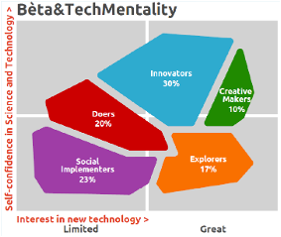
02
* Bèta & Tech Mentality Model Source: PTvT (Dutch National STEM Platform)
Educators can use the Beta & Tech Mentality Model to develop adaptability, innovation, and problem-solving in students. This approach encourages iterative learning, experimentation, viewing not as failure but as a path toward improvement by continuous experimentation.
Expanding growth mindset, ability to use project-based learning where students test, refine, and improve their ideas. By incorporating the model into the classroom and Fab Lab facilities, educators can help learners to think like innovators, embrace uncertainty, and build future-ready skills.
If you want to know more about the Bèta & Tech Mentality Model you can access the methodology here
Designing Learning Pathways
The Learning Pathways will assist educators to provide girls and women of various ages experimentation learning with:
01 Design skills, including the basics of design thinking, user-centred design, sustainable and circular design.
02 Technical skills, including digital fabrication like laser
cutting, vectorizing for example and, creating and
prototyping physical objects.
Each pathway is designed to be adaptable, ensuring that activities can be customized to suit the needs and interests of participants. By incorporating these pathways, educators can create learning environments that inspire confidence and foster lifelong engagement with STEAM.

Slide 10
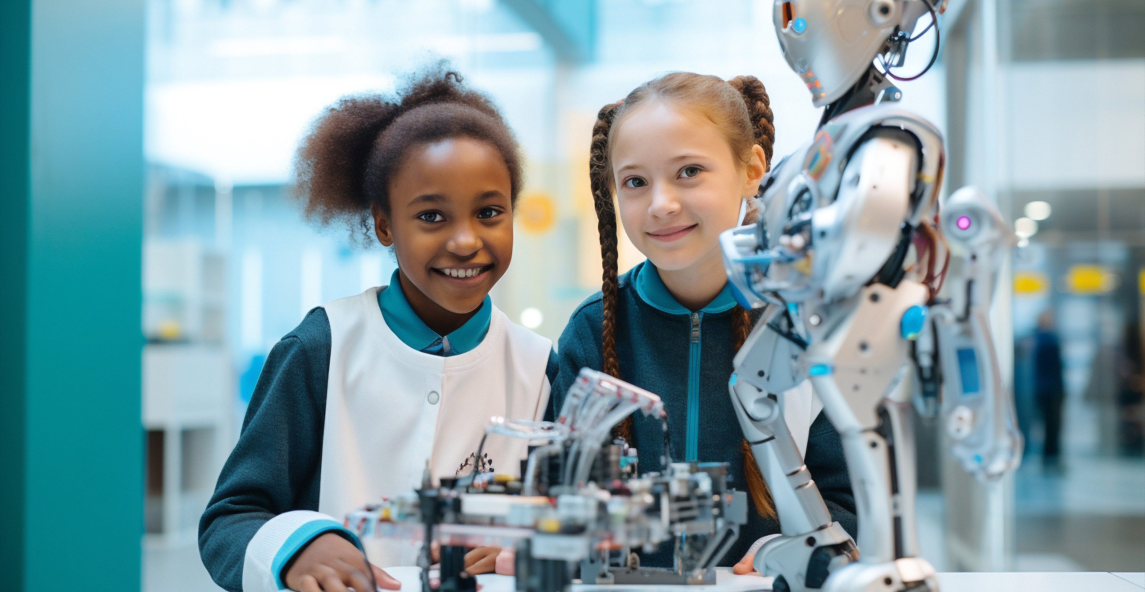
Hands-On Exploratory Path for Girls (8-15 years old)
This path aims to introduce girls to the world of STEAM through a series of engaging and interactive activities that promote creativity, problem-solving skills, and digital literacy.
The process of creating the OER1 activities for the Fab Connect Her project follows a structured and pedagogically informed approach to developing open educational resources (OERs) that promote STEAM skills, creativity, and problem-solving among young learners, particularly girls and women.
The OER1 activities are designed to foster hands-on learning experiences, integrating design, technology, and problem-solving. Each activity aligns with specific Bèta & Tech Mentality Model dimensions, targeting different learning styles and motivations. For example, the Quiz Board and Laser-Cutted Theatre activities focus on self-confidence in technology, social responsibility, and practical orientation​​.
Educators and Fab Lab practitioners create teaching materials, digital fabrication files, and lesson plans. To ensure the activities are effective and accessible, they undergo:
Classroom Pilots
Educators implement the activities, gathering student and teachers feedback on engagement and learning effectiveness.
By combining digital fabrication, open-source education, and gender-focused mentoring, the OER1 activities serve as a scalable, inclusive model for empowering future female innovators in STEAM fields.

Slide 11
Tailored Programme for Female Students (15+)
This path is designed to prepare female students for future careers in STEAM fields such as engineering, design, and manufacturing. Designed to empower women by enhancing their digital fabrication skills.
This pathway focuses on intermediate-level competencies, guiding participants through hands-on projects that involve 3D printing, laser cutting, and electronics. Through collaborative workshops and practical exercises, learners gain confidence in using FabLab tools, fostering creativity and innovation. The lessons aim to bridge the gender gap in technology by providing a supportive environment for women to develop technical skills and engage in maker culture.
While many students initially feel intimidated by working with design software, laser cutters, or 3D printers, the Beta & Tech Mentality Model helps them overcome these barriers by encouraging hands-on experimentation and iterative learning. Through carefully designed exercises, students begin to discover their strengths and interests, gradually shifting from uncertainty to confidence. A simple project - such as crafting earrings from recycled plastic caps - often sparks their curiosity and helps them realize that digital fabrication is not as complex as they first assumed. From there, they progress to more advanced tasks, like laser-cutting plexiglass for custom designs, exploring sustainability in materials, and applying design thinking to bring their ideas to life.
Beyond acquiring technical skills, students develop an entrepreneurial mindset, learning to navigate problem-solving processes, embrace challenges, and recognize that creativity and technology go hand in hand. They gain firsthand experience in digital fabrication as a tool for innovation, reinforcing the idea that STEAM fields are not only accessible but full of opportunities for personal and professional growth. By the end of their learning path, these young women leave with more than just hands-on experience - they carry with them a sense of empowerment, knowing that they have the skills and confidence to shape their future in STEAM.
Innovation and Entrepreneurship Path for Women Innovators (25+)
This path focuses on providing women innovators with the skills and knowledge necessary to start and grow their own businesses in the STEAM field, including business planning, marketing, and networking.
The Innovation and Entrepreneurship Path for Women Innovators (25+) is designed to support women in STEAM as they turn ideas into viable businesses. A key aspect of the pathway is guiding participants through hands-on challenges that reflect real-world entrepreneurial journeys. For example, one of the learning activities introduces participants to designing a market-ready prototype. A woman with a background in environmental science might start with an idea for a sustainable packaging solution. Through the pathway, she refines her concept using design thinking principles, learns to prototype using digital fabrication tools, and receives guidance on pitching her idea effectively.
Another participant might come in with an existing small business idea, such as creating custom-designed assistive devices using 3D printing. By working through the pathway’s modules on business planning and marketing, she develops a clearer brand identity, identifies potential customers, and gains the confidence to expand her reach.
A strong emphasis is placed on networking, ensuring that participants build meaningful connections. In one of the activities, participants engage in a peer-to-peer feedback session, where they present their business ideas and receive constructive input from fellow innovators. This not only helps them refine their approach but also fosters a sense of community and shared learning. The pathway has been designed to be flexible and adaptable, allowing each participant to tailor their learning journey based on their personal goals. It’s time for women in STEAM to apply these experiences, launch their innovations, and drive their businesses forward!

Slide 12
Practical Tutorials
Disclaim that this documentation was not made by the FCH project and the ownership belongs to the authors
This collection of practical resources was curated to support trainers, teachers and fab lab educators to help you develop your digital fabrication skills to better implement FabConnectHer activities.
It includes a variety of tools, tips, and tutorials in multiple formats - such as videos, PDFs, websites, and more -and in different languages to ensure accessibility for a diverse audience. Whether you're a beginner or looking to expand your expertise, these resources provide valuable guidance to support your learning journey.
English
Scopes DF https://www.scopesdf.org/
Exploratorium
Teacher Institute Hands-on science and inquiry-based learning activities for educators. https://www.exploratorium.edu/education/teacher-institute
ScratchEd
By Harvard Resources and tutorials to integrate Scratch programming into classrooms https://scratched.gse.harvard.edu/
Instructables
Teachers Section Free, classroom-tested DIY projects across science, tech, art, and more https://www.instructables.com/teachers/
Autodesk Tinkercad
Learn Section Interactive lessons for 3D design, coding, and electronics for all ages https://www.tinkercad.com/learn/designs
Design for Change
Educator Resources - Empower students to solve real-world problems through creative action. https://www.dfcworld.org/SITE/Toolkit
MIT Full STEAM Ahead
Free STEAM lessons and activities created by MIT educators.
https://fullsteam.mit.edu/
M4king Spaces
Making Spaces is an international collaboration to develop and share inclusive practices in makerspaces https://m4kingspaces.org/
A Three-Step Guide to Equitable Makerspaces
Create an inclusive and equitable culture within your makerspace by including three simple steps into your practice https://www.futurelearn.com/courses/a-three-step-guide-to-equitable-makerspaces

Slide 13
Practical Tutorials
Portuguese
3D printing
https://www.youtube.com/watch?v=ohJofHU68HE&list=PLSfAgw-TN0BJ3G0T3zYCpa0H-xxc-wJ-g
Laser cutter
https://www.youtube.com/watch?v=93RflztQPuw
Manual Maker
https://www.youtube.com/playlist?list=PLYjrJH3e_wDNLUTN32WittrpBxeleEqNp
Icelandic
3D
https://www.fabmennt.com/myndbond3d
Laser cutter
https://www.fabmennt.com/myndbondgeisla
Vinyl
https://www.fabmennt.com/myndbondviny
Dutch
3D printing, laser cutting, CNC milling and many more
3D Printing 101 | Fablab Arnhem
Smart Textiles (also availble in English)
Smart Textiles
This report provides guidance and inspiration for the transition to circular vocational education, focusing on five key themes to direct this shift: inspiratierapport-circulaire-economie_8-sectoren_sbb_2021_2.pdf
Laser Cutting Manual
LaserSnijden_JES_Astrid.pdf

Slide 14
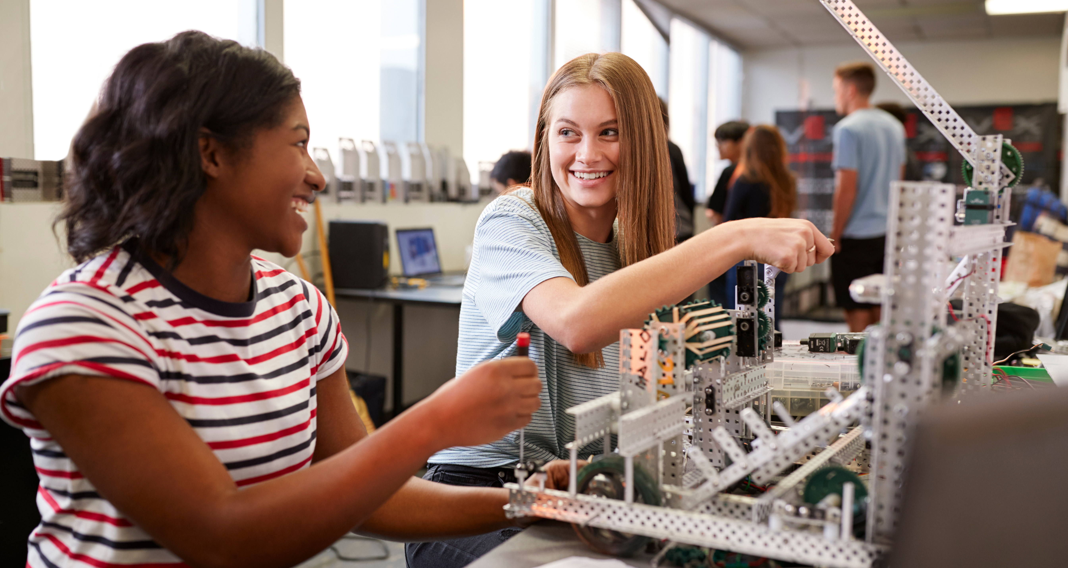
03
Ready-to-use Open Educational Resources (OER’s)
The FabConnectHer Toolbox includes ready-to-use Open Educational Resources (OERs) designed to engage learners
in creativity, technology experimentation, and entrepreneurship. Each resource has been carefully developed and tested to ensure its relevance and accessibility.
LEARNING
PATHWAYS 01
World of STEAM
for Younger Learners
LEARNING
PATHWAYS 02
Tailored Programme for Female
Students (15+)
LEARNING
PATHWAYS 03
Innovation and Entrepreneurship
Path for Women Innovators (25+)

Slide 15
LEARNING PATHWAY 01
World of STEAM for For Younger Learners
For younger learners, the exploratory pathway includes activities such as creating quiz boards to understand basic circuitry, designing mini-theatres with laser-cut components, and exploring geometry through creative crafts. These activities have been designed to be linked to the different curricula of the students and that can be included/used in different subjects.
ACCESS VIA https://fabconnecther.eu/toolbox-resource/learning-pathway-1//
Activities
Quiz board
The Quiz Board activity engages students in learning about electrical circuits while integrating laser cutting, 3D printing, and creativity by having them design and assemble interactive quiz boards using recycled materials, enhancing their understanding of various school subjects through hands-on experimentation and peer collaboration.
Taking care of myself
“Taking care of myself” presents an interactive way for young learners to discover the importance of self-care by learning about the human body parts, systems, conditions and diversity. The participants will explore human body parts, systems, conditions and how they work together by making a simple circuit representing the human body and its connections.
Conductive dough
The “Electronic Circuits with Conductive Dough” activity is a hands-on, interactive lesson designed to introduce students to the basics of electrical circuits using conductive dough (Play-Doh) and insulating dough (Jovi) and using resources from Squishy Circuits. Students will learn how to build simple circuits, differentiate between conductive and insulating materials, and create their own characters with embedded LEDs. This activity emphasizes creativity, problem-solving, and teamwork, while connecting abstract concepts of electricity to real-world applications. It is designed for students aged 8–12 and integrates principles from Natural Sciences, Technology, Art, and Mathematics.
Laser theatre
The Laser-Cut Theatre activity engages students in storytelling and creative expression while integrating laser cutting, digital design, and hands-on crafting. By designing, assembling, and decorating their own puppet theatres and characters, students enhance their understanding of literature, arts, and technology. Younger students work with pre-cut pieces, while older students learn vector design and laser cutting techniques. This interactive activity fosters collaboration, creativity, and problem-solving, making learning more engaging through performance-based storytelling and technology-enhanced creativity.
Fun Geometry
This activity aims to develop students’ spatial awareness, geometric understanding, creativity, and problem-solving skills by constructing Platonic solids and a geodesic dome using Alquimetricos resources. The lesson emphasizes real-world applications of geometry in art, architecture, and engineering while fostering teamwork and innovation. It is designed for elementary and primary school students aged 8 to 12, combining mathematics, engineering, and art to foster both technical and creative skills.

Slide 16
LEARNING PATHWAYS 02
Tailored Programme for Female Students (15+)
In the second pathway, older students engage with projects that emphasize technical and creative skills. Activities include experimenting with clay printing, designing jewelry from recycled materials, and building scaled architectural models. These projects aim to prepare learners for real-world applications and career opportunities in STEAM.
Activities
ACCESS VIA https://fabconnecther.eu/toolbox-resource/learning-pathway-2/
3D printing a Clay Object
By working with a clay 3D printer we strive to understand the basics of 3D printing and its applications. By using clay we can combine hands-on experience and move it into a 3 dimensional knowledge by learning how to design a 3D model of a vase. The lesson plan offers valuable insights and understanding into spatial knowledge, technology, software, and practical skills required to start creating your own 3D printed objects.
Making an earring from plastic caps
Learners will be shown how to create and design their own unique and eco-friendly earrings by melting plastic bottle caps, pressing them into sheets, and cutting them out. In this exercise the aim is to have a fun first interaction with designing a small object and learning about making a vector file and cut it out using a laser cutter.
Floating light project in a bottle
Learn to create a floating light project in a bottle using an LED blacklight, solar panel, Arduino, and tonic water. This project combines elements of renewable energy, programming, and chemistry. This interdisciplinary project aims to foster creativity, enhance technical skills, and provide a comprehensive understanding of how different scientific principles can be applied in a fun and engaging way.
Glass Laser Engraving
Learn how to make an image in the computer and engraving an image or text into a glass object using a laser cutter. Combine design and introduction to software usage.
Creating Perry the Platypus from MDF Wood
Learn how to create a Perry the Platypus model from MDF wood by following a drawing plan, cutting the wood, assembling the pieces, and painting the final model in their favourite colours. This exercise is a hands-on activity that gives students a chance to work with wood and tools to finalize a project. Gaining knowledge on how to use tools with guidance and following a step by step guide.
Sticker
Learn how to create your own stickers using image software and cutting it in a vinyl cutter. Basic level knowledge that can later be transferred to bigger ideas and also textile vinyl for fabric designs.
Building and launching water rockets
In this exercise the learner has the opportunity to shoot a soda bottle, transferred into a water rocket, into the sky. This lesson combines opportunities to have a discussion and learning opportunity about the universe, and physics, students learn all about space, pressure and physics.
Scanning a human face and CNC machining a 3D model
Learn how to scan a human face, convert the scan to an STL file, and observe how a CNC router is used to machine the 3D model. This project integrates skills in 3D scanning, computer-aided design (CAD), and CNC machining.

Slide 17
LEARNING PATHWAYS 03
Innovation and Entrepreneurship Path
for Women Innovators (25+)
The third pathway offers resources for aspiring entrepreneurs, guiding them through the process of ideation, prototyping, and scaling their ventures. Participants learn to develop business plans, conduct market research, and establish sustainable enterprises in STEAM industries. This pathway fosters innovation and equips participants with the tools needed for long-term success
Activities
ACCESS VIA
https://fabconnecther.eu/toolbox-resource/learning-pathway-3/
Phase 1 - Idea development and planning
The journey begins with exploring entrepreneurial potential and shaping a business idea. Participants identify their strengths using the Beta Tech Mentality Model, which categorizes them into five personas, each with a unique approach to innovation. They learn about entrepreneurship in STEAM, develop creative problem-solving skills, and create a structured business plan. By the end of this phase, participants have a refined business concept, ready for the next steps.
Phase 2 - Building and development the business
With a solid idea in place, this phase focuses on transforming concepts into tangible products or services. Participants engage in prototyping and product development, incorporating sustainability and social impact into their business models. They also gain insight into legal considerations, intellectual property, and strategies for balancing work and well-being, particularly for female entrepreneurs. By the end of this phase, they have a developed product or service with a sustainability plan and legal awareness.
Phase 3 - Growth and market entry
Once the business is ready, the focus shifts to entering the market and attracting customers. Participants learn how to craft effective marketing strategies tailored to STEAM businesses, develop sales techniques, and build strong customer relationships. They also explore funding opportunities, including grants, investments, and other financial resources. This phase equips them with the tools to establish a strong market presence and secure financial support for business growth.
Phase 4 - Scaling and long-term success
The final phase is about expansion and sustainability. Participants develop networking skills and build strategic partnerships to strengthen their business. They explore ways to scale their operations while maintaining resilience and adaptability in a rapidly changing market. By the end of this phase, they are prepared to grow their business sustainably, expand their impact, and build a long-term successful venture.

Slide 18
04
Guide to setting up and promoting a FabConnectHer Learning Centre
Learning Insights
A FabConnectHer learning insight is a key takeaway from working with diverse learners, implementing new teaching strategies, or running hands-on STEAM activities. These insights help improve your approach, making learning more inclusive, effective, and impactful.
Here are some key insights and why they matter:
01 Understanding Learner Needs
Many participants, especially from underrepresented backgrounds, may need extra support like mentoring, flexible schedules, or additional resources. Recognizing this helps ensure everyone has an equal opportunity to engage and succeed
02 Adapting Teaching Approaches
Hands-on projects and creative challenges often make technical concepts easier to grasp. When lessons are engaging and interactive, learners are more likely to stay motivated and build confidence in their skills.
03 Promoting Collaboration
Encouraging peer-to-peer learning not only strengthens technical abilities but also creates a supportive community where participants feel more confident and valued.
04 Championing Inclusion
Designing programs that reflect diverse cultural, linguistic, and socioeconomic backgrounds makes learning environments more welcoming and relatable, helping more people feel like they belong
05 Empowering Women and Girls
Showcasing real-world applications of STEAM—especially in creative and entrepreneurial fields—helps more women and girls see themselves as innovators, making a lasting impact on their confidence and career aspirations.
By applying these insights, you can create a more effective FabConnectHer Learning Centre where every participant feels included, engaged, and empowered to thrive in STEAM.

Slide 19
In this section, we present a quick guide for setting up and promoting a learning centre, this involves creating a welcoming and inclusive environment where participants can explore, learn, and innovate
01
Define the vision and objectives
Establish a clear purpose for the learning centre, including goals such as empowering women and girls in STEAM, promoting sustainability, and fostering innovation through digital fabrication.
Set up your space
Identify the physical or virtual space for your learning centre
Inspiration from Fab Lab Layout
Printed resourcesFCH Poster
Child safeguarding guideline
Upload your centre to the FCH Learning Centre map (TBC)
Fab Lab Reykjavik https://maps.app.goo.gl/FMGpEHafoTdsL8ja7
Creative Spark - Enterprise FabLab https://maps.app.goo.gl/njLhCeTgQPBRPNJs8
Fab Lab Leon https://maps.app.goo.gl/DwT5DssQgWbr1jJn7
VIVA LAB Porto https://maps.app.goo.gl/QJYLMHvjV5CAkqiFA
D’LAB https://maps.app.goo.gl/DwT5DssQgWbr1jJn7
Develop your curriculum and Learning Pathways
Using the available FCH and design your curriculum focused on STEAM skills and link it to your local education curriculum. Include hands-on projects and real-world applications from the FCH Learning Pathways.
Recruit and train instructors and mentors
Bring on board with instructors and inspiring mentors with a mindset to teach skills, provide career guidance, and promote gender equity in STEAM fields.
Promote and build partnerships
Create a strong brand and promote the centre through local collaborations, schools, women’s organizations, social media, and community engagement events.
Launch the Learning Centre
Organize a launch event to introduce the centre to the community, and ensure ongoing operations include flexible, regularly scheduled programs to accommodate participants.
Monitor, Evaluate, and Adapt
Collect feedback, measure the impact of the programme, and refine the curriculum to align with participant needs, industry trends, and new technological advancements.
Base and impact questionnaires
Showcase Success Stories and Share Results
Highlight participant achievements and publish reports to share the learning centre’s impact, helping to attract future students, sponsors, and partners.
FCH Learning Centre map TBC
02
01
02
03
04
05
06

Slide 20
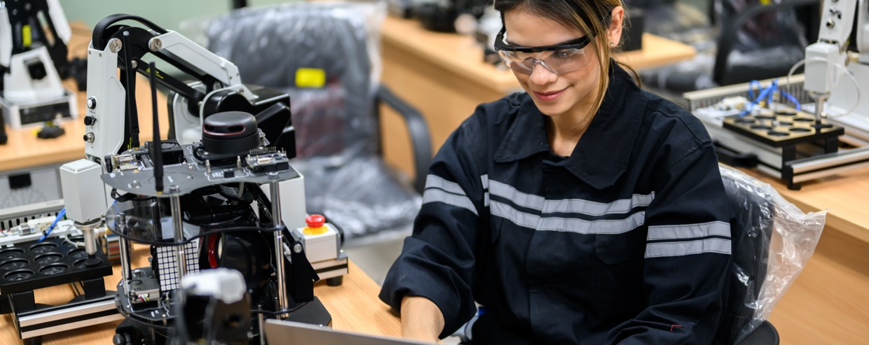
Promotion Tips for the Learning Centre:
04
01 Storytelling
Share the stories of participants who have benefitted from the program. Personal narratives can be powerful tools to inspire others to join.
02 Collaborations
Collaborate with local schools, universities, and tech organizations to co-host events or offer joint workshops.
03 Social Media Content
Post regularly with engaging visuals, behind-the-scenes moments, student success stories, and live event updates.
04 Online Courses
If resources allow, create online workshops or courses that can be accessed globally. This could increase the reach of the learning center.
05 Community Engagement
Host events like hackathons, workshops, or public talks on women in STEAM to raise awareness and engage the wider community.
Diversity and inclusion strategy
The Diversity and Inclusion Strategy for the FabConnectHer project highlights its commitment to fostering equity and engagement among diverse groups, particularly women, in STEAM fields. At its core, diversity is defined as embracing differences across gender, ethnicity, abilities, age, socioeconomic status, and beyond, while inclusion ensures that everyone has equal opportunities and a true sense of belonging.
This strategy aligns closely with the principles of the Erasmus+ program, emphasizing accessibility, fairness, and empowerment. By making the project inclusive, FabConnectHer seeks to expand participation, enrich learning opportunities, and create a positive, collaborative environment where people from all walks of life can thrive.
Access to our Diversity and Inclusion Strategy booklet to implement those strategies at your FCH Learning Centre.

Slide 21
Best practices for Sustainability
Here are some tips for you to implement at your Learning Centre, to increase the fair use of materials and the resources available at your lab.
Selection of materials
We are dedicated to selecting materials for our activities based on key principles. Our commitment extends to choosing biodegradable materials that leave no trace on the planet when disposed of. Additionally, we emphasize responsible waste disposal by sorting different materials into designated containers for proper disposal.
We advocate for:
Conscious reuse of materials, such as cardboard, paper, and disposable cups, in every activity.
limit the use of disposable containers, opting instead for reusable alternatives without plastic.
Promote the adoption of circular design principles in the planning of all our activities, aiming to create a sustainable and ecologically friendly framework for our endeavours.
To raise awareness about the carbon-free origin of the material resources to be used, the following questions could be introduced in the conversation:
Low-carbon to produce?
Long living and repairable?
Produced locally?
Plastic free?
Ethically produced?
Multifunctional?
Can you ask the producer to reduce their unnecessary packaging?
Case Studies
Case studies from projects like SHEMAKES and M4KING SPACES provide valuable insights into best practices for establishing inclusive makerspaces. These examples demonstrate how to overcome challenges and create spaces that empower learners to thrive.

Slide 22
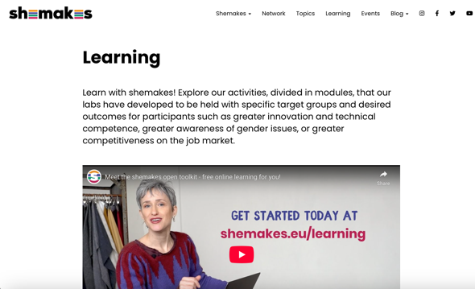
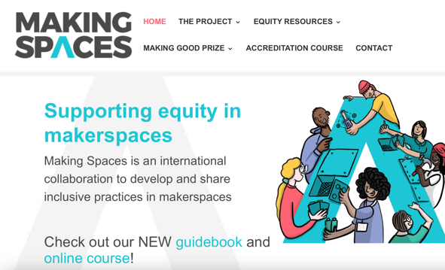
Best practices for Sustainability
SHEMAKES
The SHEMAKES project offers various learning paths designed for different age groups, focusing on empowering women, especially in areas traditionally dominated by men, like technology and textiles. These include activities for girls (8-18 years), young women (18-25 years), and entire communities, addressing gender issues, entrepreneurship, and innovation.
The activities cover skills such as laser cutting, soft circuits, modular fashion, and biomaterials. The resources and activities are shared in an open toolkit, allowing others to replicate them. More details are available here.
CLICK
TO VIEW
M4KING SPACES
The M4KING SPACES project offers a guidebook and a free online course designed to help makerspaces develop inclusive, equity-driven practices, particularly for underrepresented youth in STEM. The course, available on FutureLearn, complements the guidebook, providing tools, research, and resources to support diverse young people in their engagement with technology and creative production. More details can be found on their official website.
CLICK
TO VIEW

Slide 23
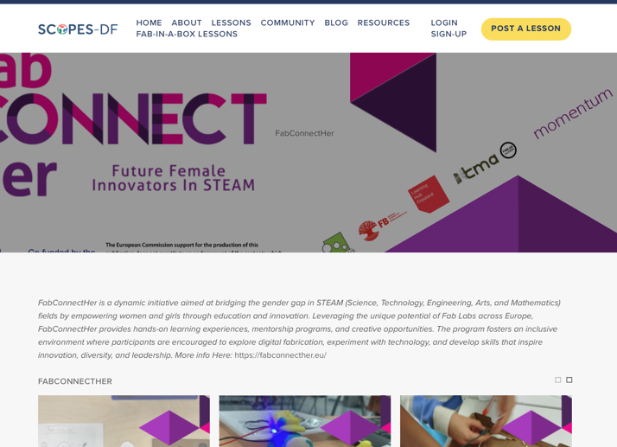
05
Promotion and Impact
SCOPES DF chapter
FabConnectHer has partners with Foundation to create an special collection to promote the lessons and resources with other fablabs.
The SCOPES-DF (Scaling a Community of Practice for Education in STEM through Digital Fabrication) platform is an initiative by the Fab Foundation aimed at transforming K–12 STEM education through the integration of digital fabrication technologies. It provides educators with innovative teaching models and students with engaging, applied learning opportunities.​
CLICK
TO VIEW

Slide 24
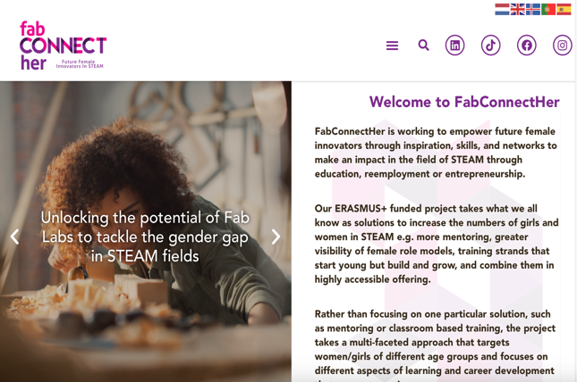
CLICK
TO VIEW
Follow our journey
L
T
F
IN
www.fabconnecther.eu

